Slide 1
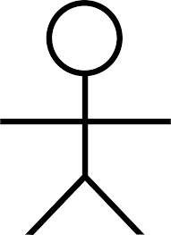
Use Case Diagram
UNITFIT- fitness Application
Use Case Diagram
Module: 04. Dashboard
04.01. Workout statistics
User

Slide 2
Use Case Diagram
UNITFIT- fitness Application
Use Case Diagram
Module: 05. Purchase Bundle
05.01 Freemium
User

Slide 3
Use Case Diagram
UNITFIT- fitness Application
Use Case Diagram
Module: 07. User Account
07.01 Modify General User's Information
07.02 Reset the password
Users
Account Manager
07.03 Delete an Account

